Slide 1
PROJECT REPORT ON SERVICE QUALITY OFHDFC BANK

Slide 2
DECLARATION
I HEARBY DECLARE THAT THE PROJECT REPORT TITLED SERVICES QUALITY OF HDFC BANK IS MY ORIGINAL WORK AND HAS NOT BEEN PUBLISHED OR SUBMITTED FOR ANY DEGREE , DIPLOMO OR ANY OTHER SIMILAR TITLES ELSEWHERE.

Slide 3
Submitted By
T.Sai Harsha (TEAM LEAD)
V.Raj Kumar V.Arvind
V.Lakshmi Sai Phani Pavan

Slide 4
PREFACE
This project report attempts to bring under one cover the entire hard work and dedication put in by me in the completion of the project work on Service Quality of HDFC bank.
I have expressed my experiences in my own simple way. I hope who goes through it will find it interesting and worth reading. All constructive feedback is cordially invited.

Slide 5
ACKNOWLEDGMENT
It is really a matter of pleasure for me to get an opportunity to thank all the persons who contributed directly or indirectly for the successful completion of the project report, "Service Quality of HDFC bank".
I wish to express my gratitude to the branch manager Mr. NAVEEN SHARMA of HDFC BANK, GOWLIOR for giving mean opportunity to be a part of their esteem organization and enhance my knowledge by granting permission to do a summer training Project. They provided me with their assistance and support whenever needed, which has been instrumental in completion of this project. I am thankful to them, for their support and encouragement throughout the tenure of the project. Also I am thankful to my faculty guide MS. AMITA ARORA from K.N.S. World Management Collage, Gurgaon, for being a source of support during this training period. Last but not the least I am grateful to all the staff members of HDFC Bank for their kind cooperation and help during the course of my project.

Slide 6
CONTENTS
INTRODUCTION
COMPANYPROFILE
SERVICEQUALITYIN BANKS
RESEARCHOBJECTIVE
RESEARCHMETHODOLOGY
DATAANALYSIS
FINDINGSOFTHEREPORT
CONCLUSION
RECOMMENDATIONS
BIBLIOGRAPHY
ANNEXURE:QUESTIONNAIRE

Slide 7
INTRODUCTION OF BANKING
Service with a smile:
Today" s finicky banking customers will settle for nothing less. The customer has come to realize somewhat belatedly that he is the king. The customer" s choice of one entity over another as his principal bank is determined by considerations of service quality rather than any other factor. He wants competitive loan rates but at the same time also wants his loan or credit card application processed in double quick time. He insists that he be promptly informed of changes in deposit rates and service charges and he bristles with customary rage" if his bank is slow to redress any grievance he may have. He cherishes the convenience of impersonal net banking but during his occasional visits to the branch he also wants the comfort of personalized human interactions and facilities that make his banking experience pleasurable. In short he wants financial house that will more than just clear his cheque and updates his passbook: he wants a bank that cares and provides great services.
So does HDFC bank meet these heightened expectations? What are the customers" perceptions of service quality of the banks? Which dimension of service quality of HDFC bank is performing well? To find out answers to these questions I undertook a survey of 2 branches of HDFC bank.
A lot of surveys have been done in the past to understand the aspect of customer satisfaction and to find out the customer friendly banks. My research is conducted to find out "SERVICE QUALITY OF HDFC BANK".

Slide 8
COMPANY PROFILE

Slide 9


Slide 10
HDFC BANK
The Housing Development Finance Corporation Limited (HDFC) was amongst the first to receive an 'in principle' approval from the Reserve Bank of India (RBI) to set up a bank in the private sector, as part of the RBI's liberalisation of the Indian Banking Industry in 1994. The bank was incorporated in August 1994 in the name of 'HDFC Bank Limited', with its registered office in Mumbai, India. HDFC Bank commenced operations as a Scheduled Commercial Bank in January 1995.
HDFC Bank comprises of a dynamic and enthusiastic team determined to accomplish the vision of becoming a World-class Indian bank. HDFC bank" s business philosophy is based on our four core values - Customer Focus, Operational Excellence, Product Leadership and People. They believe that the ultimate identity and success of their bank will reside in the exceptional quality of people and their extraordinary efforts.
They are committed to hiring, developing, motivating and retaining the best people in the industry.

Slide 11
SERVICE QUALITY IN BANKS

Slide 12
QUALITY POLICY
SECURITY: The bank provides long term financial security to their policy. The bank does this by offering life insurance and pension products.
TRUST: The bank appreciates the trust placed by their policy holders in the bank. Hence, it will aim to manage their investments very carefully and live up to this trust.
INNOVATION: Recognizing the different needs of our customers, the bank offers a range of innovative products to meet these needs.
INTEGRITY CUSTOMER CENTRIC
PEOPLE CARE "ONE FOR ALL AND ALL FOR ONE" TEAM WORK
JOY AND SIMPLICITY

Slide 13
In the days of intense competition, the banks are no different from any other consumer marketing company. It has become essential for the service firms in general and banks in particular to identify what the customer's requirements are and how those customer requirements can be met effectively. In the days where product and price differences are blurred, superior service by the service provider is the only differentiator left before the banks to attract, retain and partner with the customers. Superior service quality enables a firm to differentiate itself from its competition, gain a sustainable competitive advantage, and enhance efficiency.The benefits of service quality include increased customer satisfaction, improved customer retention, positive word of mouth, reduced staff turnover, decreased operating costs, enlarged market share, increased profitability, and improved financial performance. The construct of service quality has therefore been a subject of great interest to service marketing researchers.
Service quality has been defined by various experts in various ways as: 'Service Quality is the difference between customers' expectations for service performance prior to the service encounter and their perceptions of the service received.' According to Gefan Service quality is the subjective comparison that customers make between the qualities of service that they want to receive and what they actually get.' Parasuraman says, 'Service quality is determined by the differences between customer's expectations of services provider's performance and their evaluation of the services they received. Service quality is 'the delivery of excellent or superior service relative to customer expectations". Service quality is recognized as a multidimensional construct. While the number of dimensions often varies from researcher to researcher, there is some consensus that service quality consists of three primary aspects: outcome quality, interaction quality, and physical service environment quality. Outcome quality refers to the customer's assessment of the core service which is the prime motivating factor for obtaining the services (e.g. money received from ATM). Interaction quality refers to the customer's assessment of the service delivery process, which is typically rendered via a physical interface between the service provider, in person, or via technical equipment, and the customer. It includes, for instance, the consumer's evaluation of the attitude of the service providing staff. The physical service environment quality dimension refers to the consumer's evaluation of any tangible aspect associated with the facilities or equipment that the service is provided in/with. It includes, for example, the physical conditions of an ATM machine.

Slide 14
The most popular dimensions of service quality--features five dimensions: tangibles, reliability, responsiveness, empathy, and assurance. The tangibles dimension corresponds to the aforementioned physical environment aspect, the reliability dimension corresponds to the service outcome aspect, and the remaining three represent aspects of interaction quality. Both the costs and the revenue of firms are affected by repeat purchases, positive word-of-mouth recommendation, and customer feedback. Moreover, there is strong evidence that service quality has either a direct influence on the behavioral intentions of customers and/or an indirect influence on such intentions, mediated through customer satisfaction. RATER is an instrument that might be used to define and measure banking service quality and to create useful quality-assessment tools.
The RATER may finally provide the following benefits to the HDFC bank:
It is the first approach to add and mix the customers" religious beliefs and cultural values with other quality dimensions.
It provides for multi-faced analysis of customer satisfaction.
It links quality with customers" satisfaction and service encounter.
It provides information at several levels, already organized into meaningful groupings.
It is a proven approach, which results in usable answers to meet customers" needs.
It is empirically grounded, systematic and well documented. Banks managers can use the RATER model and its dimensions first to identify the following issues:

Slide 15
DIMENSIONS OF SERVICE QUALITY
TANGIBILITY: This dimension deal with modern looking equipments and visual appealing part of banks.
RELIABILITY: This dimension has a direct positive effect on perceived service quality and customer satisfaction in banking institutions. Banks must provide error free service and secure online transactions to make customers feel comfortable.
RESPONSIVENESS: Customers expect that the banks must respond their inquiry
promptly. Responsiveness describes how often a bank voluntarily provides services that are important to its customers. Researchers examining the responsiveness of banking services have highlighted the importance of perceived service quality and customer satisfaction.
ASSURANCE: Customer expects that the bank must be secured and the behavior of the employees must be encouraging.
EMPATHY: individual attention, customized service and convenient banking hours are very much important in today" s service.
In order to achieve better understanding of service quality in banking sector, the proposed five service quality dimensions are conceptualized to illustrate the overall service quality of the banking in relation to customers" and providers perspective.

Slide 16
service is determined to a large extent by the skills and attitudes of people producing the service.
In the case of services, because customers are often either direct observers of the production process or active participants, how the process is performed also has a strong influence on the overall impression of the quality of service. A well-performed service encounter may even overcome the negative impression caused by poor technical quality as well as generate positive word-of-mouth, particularly if customers can see that employees have worked very hard to satisfy them in the face of problems outside their control. Employees are part of the process, which connects with the customer at the point of sale, and hence employees remain the key to success at these service encounters or "moments of truth". It is these encounters with customers during a service that are the most important determinants of overall customer satisfaction, and a customer" s experience with the service will be defined by the brief experience with the firm" s personnel and the firm" s systems. The rudeness of the bank" s customer service representative, the abruptness of the employee at the teller counter, or the lack of interest of the person at the check deposit counter can alter one" s overall attitude towards the service, perhaps even reversing the impression caused by high technical quality.
Another important service quality factor, competence, is defined by whether the bank performs the service right the first time, whether the employees of the bank tell customers exactly when services will be performed, whether the bank lives up to its promises, whether customers feel safe in their transactions with the bank and whether the employees show a sincere interest in solving the customers" problems. In short, this dimension is related to the banks" ability to perform the promised service accurately and dependably. Performing the service dependably and accurately is the heart of service marketing excellence. When a company performs a service carelessly, when it makes avoidable mistakes, and when it fails to deliver on promises made to attract customers, it shakes
customers" confidence in its capabilities and undermines its chances of earning a reputation for service excellence.

Slide 17
However, companies fare best when they prevent service problems altogether and fare worst when service problems occur and the company either ignores them or does not resolve them to the customer" s satisfaction.
Performing the service accurately is perhaps the most important factor in service quality excellence. The cost of performing the service inaccurately includes not only the cost of redoing the service but also the cost associated with negative word-of-mouth generated by displeased customers. In case of services, the factory is the field.
Again, services are intangible and hence the criteria for flawless services are more subjective than the criteria for defect- free tangible goods. Hence for most services, customers" perceptions of whether the service has been performed correctly, and not provider- established criteria, are the major determinants of reliability.
The service quality factor tangible is defined by whether the physical facilities and materials associated with the service are visually appealing at the bank. These are all factors that customers notice before or upon entering the bank. Such visual factors help consumers form their initial impressions. A crucial challenge in service marketing is that customers cannot see a service but can see the various tangibles associated with it - all these tangibles, the service facilities, equipment and communication materials are clues about the intangible service. If unmanaged, these clues can send to the customer" s wrong messages about the service and render ineffective the marketing strategy of the company. On the other hand, improving quality through tangibles means attention to the smallest details that competitors might consider trivial. Yet, these visible details can add up for customers and signal a message of caring and competence.
Customers may reveal new aspects of service quality in banking that are important to them, and these would have to be incorporated in the scale so as to further explore the concept of service quality in the banking arena.

Slide 18
RESEARCH OBJECTIVE
AND RESEARCH METHODOLOGY

Slide 19
RESEARCH OBJECTIVE
The objective of the study is as follows:
To examine the essential dimensions of service quality i.e. RATER- Reliability, assurance, tangibles, empathy and responsiveness of HDFC bank and its effect on customer" s satisfaction.
To find out the level of perception of the customers from the service quality offered by the banks.
To know which service quality dimension of the bank is performing well.
To identify which dimension of service quality needs improvement so that the quality of service of HDFC banks is enhanced.

Slide 20
RESEARCH METHODOLOGY
DATA SOURCE
Primary Data:
The primary data was collected by means of a survey. Questionnaires were prepared and customers of the banks at two branches were approached to fill up the questionnaires. The questionnaire contains 20 questions which reflect on the type and quality of services provided by the banks to the customers. The response of the customer and the is recorded on a grade scale of strongly disagree, disagree, uncertain, agree and strongly agree for each question. The filled up information was later analyzed to obtain the required interpretation and the findings.
Secondary Data:
In order to have a proper understanding of the service quality of bank a depth study was done from the various sources such as books, a lot of data is also collected from the official websites of the banks and the articles from various search engines like Google, yahoo search and answers.com.
RESEARCH DESIGN
The research design is exploratory till identification of service quality parameters. Later it becomes descriptive when it comes to evaluating customer perception of service quality of the banks.
Descriptive research, also known as statistical research, describes data and characteristics about the population

Slide 21
The description is used for frequencies, averages and other statistical calculations. Often the best approach, prior to writing descriptive research, is to conduct a survey investigation.
Qualitative research often has the aim of description and researchers may follow-up with examinations of why the observations exist and what the implications of the findings are
RESEARCH SAMPLE SAMPLING PLAN:
Since it is not possible to study whole universe, it becomes necessary to take sample from the universe to know about its characteristics.
Sampling Units: Customers of HDFC bank Sample Technique: Random Sampling.
➤ Research Instrument: Structured Questionnaire.
Contact Method: Personal Interview.

Slide 22
DATA ANALYSIS

Slide 23
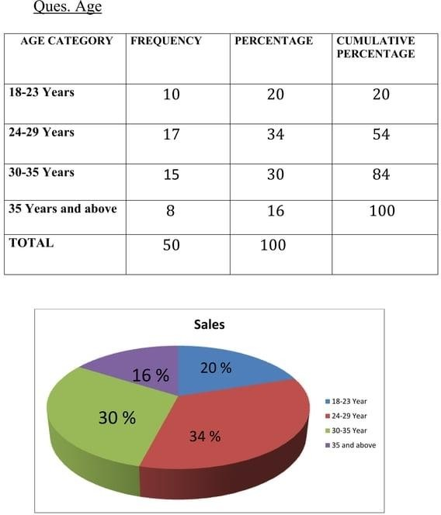

Slide 24
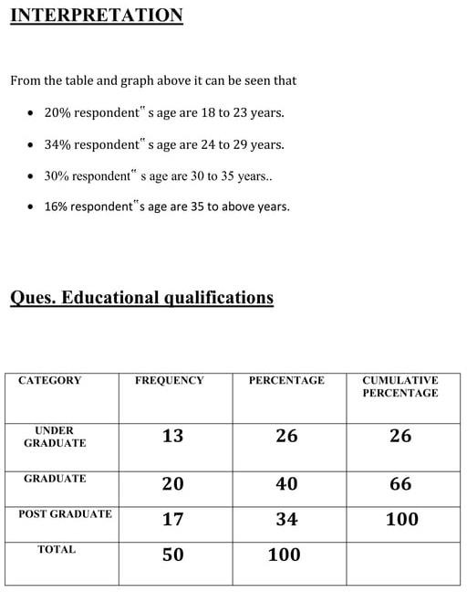

Slide 25
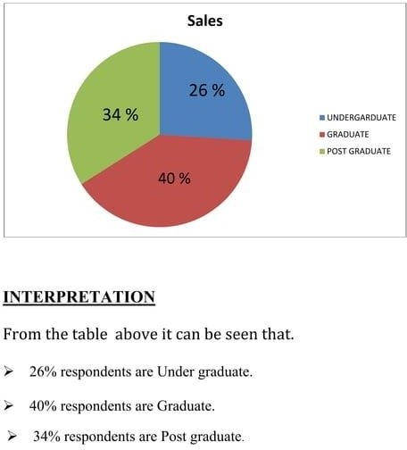

Slide 26
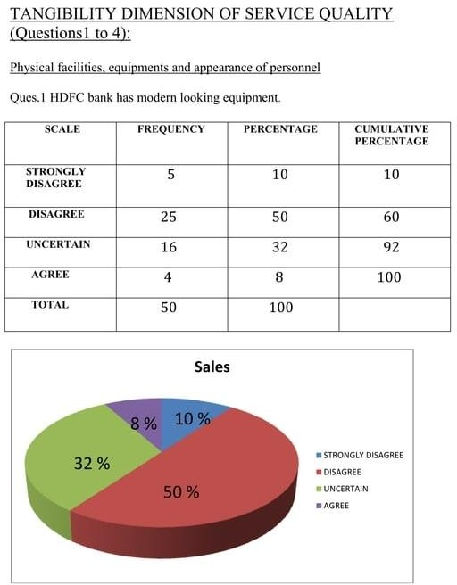

Slide 27
MEASURING SERVICE QUALITY DIMENSIONS
Measuring the quality of a service can be a very difficult exercise. Unlike product where there are specific specifications such as length, depth, width, weight, colour etc. a service can have numerous intangible or qualitative specifications.
Parasuraman, Zeithaml, and Berry (1985) provide a list of determinants of service quality: access, communication, competence, courtesy, credibility, reliability, responsiveness, security, understanding, and tangibles. A total of five consolidated dimensions of service quality are:
Tangibles (ques.1 to 4) - Physical facilities, equipments and appearance of personnel Reliability (ques.5 to 8) -
Ability to perform the promised service dependably
and accurately
Responsiveness (ques.9 to 12) - Willingness to help customers and provide prompt services
Assurance (ques.13 to 16) - (including competence, courtesy, credibility and
security) Knowledge and courtesy of employees and their ability to inspire trust and confidence

Slide 28
Empathy (ques.17 to 20) - (including access, communication and understanding the customer) Caring and individualized attention that firm provides to its customer.
In order to calculate which dimension of service quality is performing well, a
sample of the questions are used in the questionnaire. Using the questionnaire, obtain the score for each of the 20 statements. After analysis of the data, Overall score to each statement is given on a scale of 1 to 5 i.e. 1 is given to strongly disagreed i.e. the lowest score, then 2= disagreed, 3= uncertain, 4= agreed and 5= strongly agreed.
Sum the score for each dimension of service quality to obtain a final score
which tells which dimension is performing well and which dimension needs improvement.

Slide 29
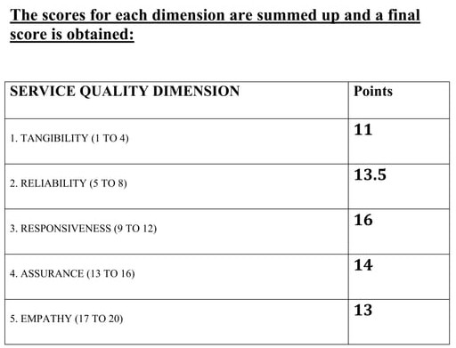

Slide 30
FINDINGS OF THE REPORT
The Reliability dimension of service quality is better as compared to empathy and tangibility. Still the score is low. For most services, customer" s perceptions of whether the service has been performed correctly, and not provider-established criteria, are the major determinants of reliability. Customers of the bank hesitate to rely on the bank. Whenever they have a problem, the bank shows sincere interest in solving it but the services are not performed by a certain time as promised. The employees should take this problem seriously and take steps to remove this.
As score for Assurance is at second place after responsiveness, so the customers of HDFC bank are very confident and feel safe while transacting with the bank. Moreover the employees of the bank have proved to be trustworthy. Employees are also educated enough to answer all the questions.
The score of Tangibility dimension of service quality of HDFC bank is the lowest. The service quality factor tangible is defined by whether the physical facilities and materials associated with the service are visually appealing at the bank. These are all factors that customers notice before or upon entering the bank.
Customer expectations regarding visual appealing of HDFC is very high. From my study I found that Physical facilities and modern looking equipment are not sufficient in HDFC bank. Respondents were uncertain about the neat appearance of the reception desk employees. So they should work on that and try to fulfill the gap.

Slide 31
According to my findings, the score of Empathy is not satisfactory but not unsatisfactory also. HDFC bank is unable to give individual attention to its customers and is unable to understand specific needs of its customers. But still bank has taken steps to satisfy its customers by keeping operating hours convenient to its customers and keeping their interest best at heart.
In HDFC bank, the score of Responsiveness is highest so they are focusing on prompt service, employees are willing to help the customers and say the exact time when the services will be performed. Employees at bank give their customers first preference and are always ready to help them. Overall HDFC bank" s responsiveness dimension of service quality is the highest.
According to the customer perception, HDFC bank is highly responsive. Customers are assured while transacting with the bank. The reliability dimension is lower than the first to dimension. They feel that the bank is unable to give them individual attention and its equipments are not modern and sufficient for the bank.
➤ There is not much gap between all the dimensions, this shows that HDFC BANK is a better service provider in all the dimensions i.e. reliability, assurance, tangibility, responsiveness and empathy. As a result of which, the customers are satisfied with the service offered by HDFC bank.

Slide 32
CONCLUSION
Based on the study conducted it can be concluded that responsiveness, assurance and reliability are the critical dimensions of service quality of HDFC bank and they are directly related to overall service quality. The factors that may delight customers tend to be concerned more with the intangible nature of the service, commitment, attentiveness, friendliness, care, and courtesy.
The employees give prompt services, always are ready to answer the questions and are trustworthy. The main sources of dissatisfaction appear to be cleanliness, up to date technology modern equipments, and neatly dressed up employees. The Tangibility dimension of service quality of HDFC bank is highly disappointing and serious steps are needed to be taken to enhance this dimension. Customers of the bank are dissatisfied with the empathy dimension. To satisfy these customers, the management can take some attempts, noted earlier as recommendations.
The study brings about the areas which require urgent attention of the employees, the management, and the policy makers of the industry. These are areas in which customers are hugely dissatisfied with the services of the banks against their expectation. This high degree of dissatisfaction resulting from the services received clearly questions the design of services or subsequent response of the bank employees. These limitations are too serious to be avoided as these question the front-line people dealing with the customers and the approach of the management in taking customers seriously

Slide 33
The management should understand the benefits of service quality. It include increased customer satisfaction, improved customer retention, positive word of mouth, reduced staff turnover, decreased operating costs, enlarged market share, increased profitability, and improved financial performance. In the days of intense competition, superior service is the only differentiator left before the banks to attract, retain and partner with the customers. Superior service quality enables a firm to differentiate itself from its competition, gain a sustainable competitive advantage, and enhance efficiency.
Thus, improving service quality leads to the customer satisfaction and, ultimately, to customer loyalty.

Slide 34
RECOMMENDATIONS
Reliability is an obvious place to start. Customers of the bank want to know their resources are safe and within trustworthy institutions. A way to ensure this peace of mind would be to take steps to ensure bank employees are well trained, so each bank associate is able to offer complete and comprehensive information at all times. Consistent policies combined with a knowledgeable staff will foster a high degree of institutional cohesion and reliability.
Responsiveness, again when associated with a well-trained staff and timely answers to service- related questions, would make significant inroads into causing HDFC bank be regarded as responsive. Staff should be encouraged to present relevant options to banking customers in a manner that does not resemble salesmanship so much as a desire to serve.
➤ Intangibles please customers just as much as tangibles in the banking industry. People tend to visit the same branch of a bank over and over again. Usually, this is a location close to their home or their workplace. It is natural that customers become comfortable and habituated to these branch banks, for the same reason they develop familiarity with a neighborhood supermarket or convenience store. It makes sense that bank employees would be encouraged to learn to recognize these regular customers, learn their names, and begin to identify their basic service requirements.

Slide 35
Learning to understand customers" needs will allow bank associates to offer enhanced services, perhaps lowering customers" banking costs and increasing their investment potential. This could also open up the possibility of increased profits for banks, for when perceived as more service and customer oriented, they will, in effect, become a useful and pleasant way to "shop."
Keeping the bank with up-to-date technologically are important factors. Modern equipments, new improved technology should be replaced with the old ones. If the staff inside is pleasant and well-informed, in an aesthetically pleasing environment, then customer satisfaction will be high.
The five-dimensional structure could possibly serve as a meaningful framework for tracking a bank" s service quality performance over time and comparing it against the performance of competitors. Items on some dimensions should be expanded if that is necessary for reliability.
Thus, the banking industries must continuously measure and improve these dimensions in order to gain customers" loyalty.

Slide 36
BIBLIOGRAPHY
References
Kotler Philip, marketing management, (Pearson education, 12th edition) Malhotra K. Naresh, marketing research (An applied orientation). Research design, (Prentice hall of India pvt. 5th edition)
Zeithmal V. A., Grembler D.D., Bitner M.j., and Pandit A.: Service Marketing Integrated customer Focus across the Firm" (4th Edition) M.K. Rampal Service Marketing
Websites www.hdfcbank.com www.hdfcindia.com www.wikipedia.org www.marketresearch.com

Slide 37
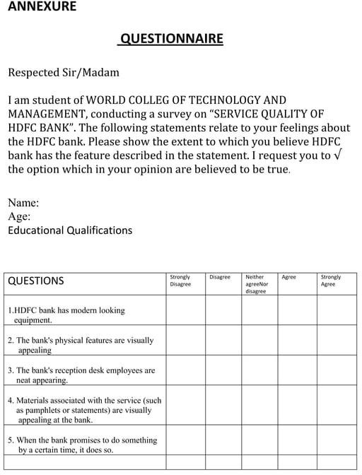

Slide 38
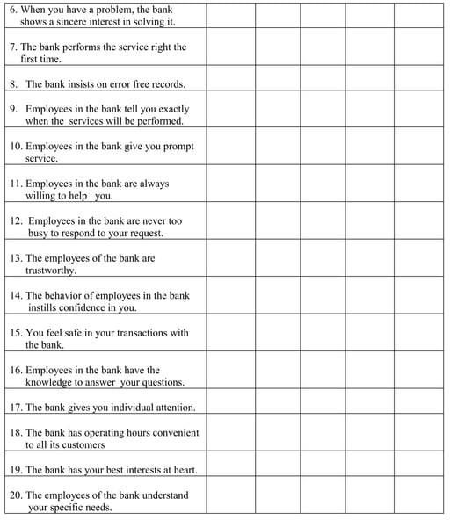

Slide 39
THE END

Slide 40


